Slide 1

Anonymity, security, privacy, and civil liberties - PPIT (CSC110)
Courtesy:
Dr. Muzafar Khan, CS Dept., CIIT, Islamabad
The content based on Chapter 5, Ethical and Social Issues in the Information Age, J. M. Kizza, 5th Edition, Springer, 2013
Notes:
NOTE:
To change the image on this slide, select the picture and delete it. Then click the Pictures icon in the placeholder to insert your own image.

Slide 2
Outline
Anonymity
Security
Privacy
Ethical and legal framework for information

Slide 3
Introduction
Dramatical increase of information due to social, economical, and technological advances
New challenges due to increased demand and easy access to information
Information is a treasure in itself
Information can be a liability
We constantly need the methods to acquire, keep, and dispose of the information
We need anonymity, security, privacy, and the safeguard of our civil liberties
Main contributing factors
High digitalization of information and increasing bandwidth
Declining costs of digital communication
Increased miniaturization of mobile computing devices and other communications equipment
Greater public awareness by the news media of the potential abuse of digital communication
Notes:
Miniaturization is the process of minimizing size of devices for ease of use like smart phones, watches and other electronic equipments.

Slide 4
Anonymity
The state of being nameless
How will be the life with total anonymity?
Types of anonymity
Pseudo identity
Individual is identified by a certain pseudonym, code, or number
Untraceable identity
One is not known by any name
Anonymity with a pseudo address to receive and send correspondence with others
Anonymity and the Internet
Internet has created a fertile ground for all faceless people to come out in the open
Anonymous servers
Full anonymity servers: no identifying information is forwarded in packet headers
Pseudonymous servers: put pseudonym in forwarded packet headers, keeping the real identity behind a pseudonym
Anonymous users

Slide 5
Advantages and Disadvantages of Anonymity
Advantages
Good for whistle-blowers
Good in case of national security
When there is intimidation and fear of reprisals
Good for some relationships and the security of some people
Disadvantages
Criminals and embezzlers can use it to their advantage, especially in online social networks
Lots of disputes could be solved if information from individuals party to these disputes can reveal the necessary information
Legal view of anonymity
In the current environment of the Internet, there are serious debates on the freedoms of individuals on the Internet and how these freedoms can be protected in the onslaught of people under the anonymity in cyberspace.

Slide 6
Security
To prevent unauthorized access, use, alteration, and theft or physical damage to property
Confidentiality
To prevent unauthorized disclosure of information to third parties
medical, financial, academic, and criminal records.
Integrity
To prevent unauthorized modification of files and maintain the status quo. It includes system, information, and personnel integrity. The alteration of information may be caused by a desire for personal gain or a need for revenge.
Availability
To prevent unauthorized withholding of information

Slide 7
Physical Security
A facility is physically secure if it is surrounded by a barrier
Physical security can be guaranteed if the following four mechanisms are in place
Deterrence: by creating an atmosphere intended to scare intruders
Prevention: by trying to stop intruders from gaining access
Detection: to “see” that intruder who has gained or who is trying to gain access
Response: to respond to the failure of the first three mechanisms
Physical access controls
Physical security barriers
Fence made of barbed wire, brick walls, natural trees, mounted noise or vibration sensors, security lighting, close circuit television (CCTV), buried seismic sensors, or different photoelectric and microwave systems
Locks and keys, window breakage detectors, infrared and ultrasonic detectors, interior microwave systems, animal like dogs, and human barriers like security guards and others

Slide 8
Electronic access controls
Password
Never publicize a password.
Never write a password down anywhere.
Never choose a password that is easy to guess.
Never keep the same password for an extended period of time.
Firewalls
packet filters
These are packet-level filters. They contain gates that allow packets to
pass through if they satisfy a minimum set of conditions and choke or prevent those packets that do not meet the entry conditions. The minimum conditions may include to have permissible origin or destination addresses
proxy servers
stateful inspection
Combine both filter and proxy function

Slide 9
Information Security Controls
Information security controls
Integrity, confidentiality, and availability of information at the servers
Encryption
Protects the communications channel from unauthorized access
Symmetric encryption
Symmetric encryption, or secret-key encryption uses a common key and the same cryptographic algorithm to scramble and unscramble the message. The security of the transmitted data depends on the fact that eavesdroppers with no knowledge of the key are unable to read the message. One problem with symmetric encryption is the security of the keys which must be passed from the sender to the receiver.

Slide 10
Information Security Controls
Asymmetric encryption
Asymmetric encryption, commonly known as public-key encryption, uses two different keys, a public key known by all and a private key known by only the sender and the receiver.
Both the sender and the receiver each have a pair of these keys, one public and one private.
To encrypt a message, from sender A to receiver B both A and B must create their own pairs of keys.
Then A and B exchange their public keys—anybody can acquire them. When A is to send a message M to B, A uses B’s public key to encrypt M.
On receipt of M, B then uses his or her private key to decrypt the message M.

Slide 11
Information Security Controls
Hash function
A hash function takes an input message M and creates a code from it. The code commonly is referred to as a hash or a message. A one-way hash function is used to create a digital signature of the message—just like a human fingerprint. The hash function is therefore used to provide the message’s integrity and authenticity.
Authentication
Authentication is a process whereby the system gathers and builds up information about the user to assure that the user is genuine. The digital signature is similar to a handwritten signature in printed documents.
Just like handwritten signatures, digital signatures ensure that the person whose signature the system is authenticating is indeed the right person, but digital signatures provide a greater degree of security than handwritten signatures. Also, digital signatures once submitted can never be disowned by the signer of a document claiming the signature was forged. This is called non-repudiation.
A secure digital signature system consists of two parts: (1) a method of signing a document and (2) authentication that the signature was actually generated by whoever it represents.

Slide 12
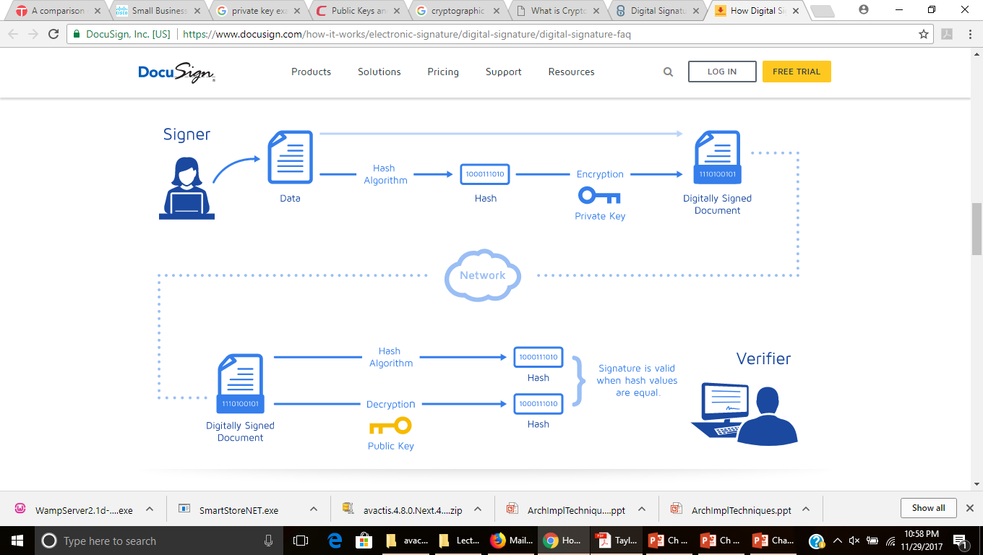
Information Security Controls
The process of signing the document, that is, creating a digital signature, involves a sender A passing the original message M into a hash function H to produce a message digest. Then A encrypts M together with the message digest using either symmetric or asymmetric encryption, and then sends the combo to B.
Upon receipt of the package, B separates the digital signature from the encrypted message. The message M is put into a one-way hash to produce a message digest, and B compares the output of the hash function with the message digest A sent. If they match, then the integrity of the message M and the signature of the sender are both valid
https://www.docusign.com/how-it-works/electronic-signature/digital-signature/digital-signature-faq

Slide 13
Information Security Controls
Operational security
Operation security involves policies and guidelines that organizations including all employees must do to safeguard the assets of the organization including its workers.
These policy guidelines are spelt out in a document we call a security policy. It also includes guidelines for security recovery and response in case of a security incident.

Slide 14
Privacy
A human value consisting of four elements (rights)
Solitude: the right to be alone without disturbances
Anonymity: the right to have no public personal identity
Intimacy: the right not to be monitored
Reserve: The right to control one’s personal information including the methods of dissemination of that information
It depends on things like culture, geographical location, political systems, religious beliefs etc.
Notes:
Intimacy = close friendship/familiarity

Slide 15
Types of Privacy
Personal privacy
Privacy of personal attributes
Prevention of anyone or anything that would intrude or violate that personal space
Law exists to protect it
Informational privacy
Protection of unauthorized access to information itself
Personal information
Financial information
Medical information
Internet
Institutional privacy
Protection of organizational data

Slide 16
Value of Privacy
Privacy has traditionally been perceived as valuable and has gained more importance in the information age. It has following attributes:
Personal identity
When information becomes more precious, it is more important to safeguard personal identity
Autonomy
The less personal information people have about an individual, the more autonomous that individual can be
People usually tend to establish relationships and associations with individuals and groups that will respect their personal autonomy
Social relationships
Collection of information as much as possible before building the relationship
Sometimes people try to hide information that may lead to breakup of the relationship

Slide 17
Privacy Implications of Database System
We help information seekers in gathering information from us
The collected information is put into databases and is later sold to the highest bidder
Information gathering is a very serious business
Individuals, companies and governments are all competing, sometimes for the same information
Internet crawlers are in action visiting our machines stealthy and gathering a wealth of information
US law enforce organizations to disclose:
Privacy policy
Right to opt out
Safeguards

Slide 18
Privacy Violations
Causes of violations
Consumers willingly give up information about themselves
Consumers lack the knowledge of how what they consider a little bit of information can turn into a big invasion of privacy
Inadequate privacy policies
Failure of companies and institutions to follow their own privacy policies
Internet temptation that enables businesses to reach individuals in a very short time in the privacy of their homes and offices
Different types of violations
Intrusion
Misuse of information
Interception of information
Information matching

Slide 19
Privacy Protection and Civil Liberties
The most accepted set of civil liberties are grouped into the following:
Criminal justice that includes police powers, personal liberty, and the right to a fair trial
Basic freedoms of speech, assembly, association, movement, and no discrimination
Freedom of information
Communications and privacy
The guidelines that safeguard and protect privacy rights are classified into the following”
Technical
Contractual
Legal

